Slide 1
Divide-and-Conquer

Slide 2
Divide-and-Conquer Technique
The most-well known algorithm design strategy:
Divide instance of problem into two or more smaller instances
Solve smaller instances recursively
Obtain solution to original (larger) instance by combining these solutions

Slide 3
Divide-and-Conquer Technique (cont.)
a problem of size n
(instance)
subproblem 1
of size n/2
subproblem 2
of size n/2
a solution to
subproblem 1
a solution to
subproblem 2
a solution to
the original problem
It general leads to a recursive algorithm!

Slide 4
Divide-and-Conquer Examples
Merge sort
Quicksort
Matrix multiplication: Strassen’s algorithm
Multiplication of large integers

Slide 5
Mergesort

Slide 6
Merge sort Example

Slide 7
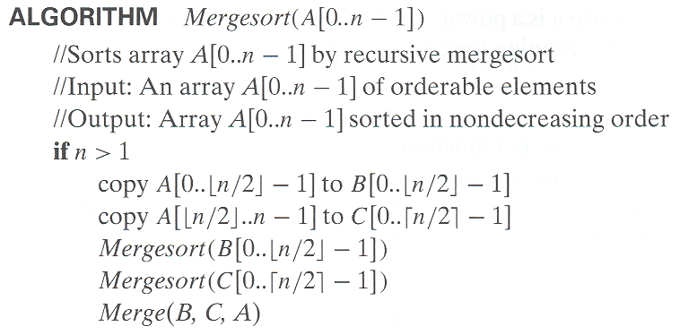
Pseudocode of Mergesort

Slide 8
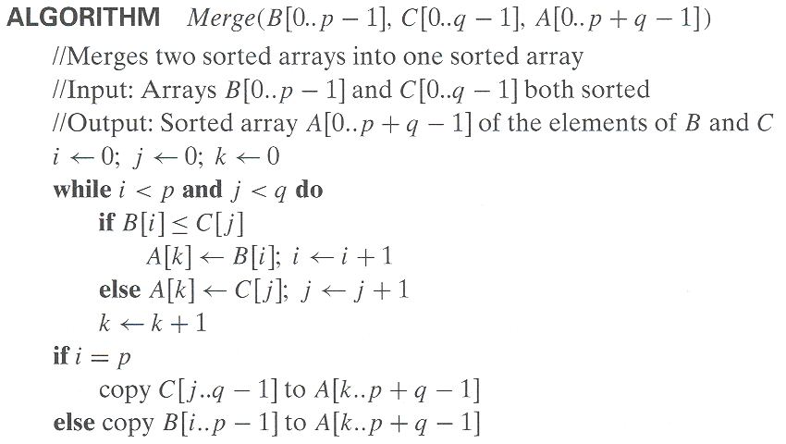
Pseudocode of Mergesort
Time complexity: Θ(p + q) = Θ(n) comparisons

Slide 9
Merge
B=[2, 4, 15, 20] C= [ 1, 16, 100, 120] merge B &C in A
i=0 j=0 k=0
B[i]=2 > C[j] = 1 therefore A[0]=1 k=1, j=1
B[i]=2 < c[j]=16 therefore A[1]= 2 k=2, i=1
B[i]=4 < c[j]=16 A[2]=4 i=2, k = 3
B[i]=15 < c[j]=16 A[3]= 15 i=3, k=4
B[i]=20 > c[j]=16 A[4]= 16 k=4, j= 2
B[i]=20 < c[2]=100 A[5] = 20 k=5 , i=4
i>3 therefore copy remaining element of C in A
A[6]=100 A[7]=120
A[] =[1, 2, 4, 15, 16, 20, 100, 120]

Slide 10
Analysis of Mergesort
Let T(n) denote time complexity of sorting n elements using merge sort then :
T(n) = 2T(n/2) + cn, T(1) = 0 for some constant c

Slide 11
Analysis of Merge sort
For simplification purpose assume n = 2^{k} for some positive constant k
T(n) = 2T(n/2) + Cn, where c is a constant
T(n) = 2[2T(n/2²) + Cn/2] + Cn = 2² T(n/ 2²) + 2Cn
T(n) = 2²[2T(n/2³) + Cn/2²] + 2Cn
T(n) = 2³ T(n/ 2³) + 3Cn
………..
………..
………..
T(n) = 2^{k} T(n/ 2^{k}) + kCn
Therefore, T(n) = 2^{k} T(1) + kCn = k Cn (since T(1)=0)
Which implies T (n) = O (kn) = O(n logn)
[since n = 2^{k}, k = log n]

Slide 12
Analysis of Merge sort (Using Masters Theorem)
T(n) = aT(n/b) + f (n) where f(n) ∈ Θ(n^{d}), d ≥ 0
Master Theorem: If a < b^{d}, T(n) ∈ Θ(n^{d})
If a = b^{d}, T(n) ∈ Θ(n^{d} log n)
If a > b^{d}, T(n) ∈ Θ(n^{log b a} )
T(n) = 2T(n/2) + cn, T(1) = 0 for some constant c
Comparing the Recurrence Relation with the Masters Theorem we get
a= 2, b=2, d=1
Using Masters Theorem
a = b^{d}
Therefore T(n) ∈ Θ(n^{d} log n)
=> T(n) ∈ Θ(n log n)

Slide 13
Quick Sort

Slide 14
Quick Sort
Small instance has n <= 1. Every small instance is a sorted instance.
To sort a large instance, select a pivot element from out of the n elements.
Partition the n elements into 3 groups left, middle and right.
The middle group contains only the pivot element.
All elements in the left group are <= pivot.
All elements in the right group are >= pivot.
Sort left and right groups recursively.
Answer is sorted left group, followed by middle group followed by sorted right group.

Slide 15
Example
6
2
8
5
11
10
4
1
9
7
3
Use 6 as the pivot.
2
5
4
1
3
6
7
9
10
11
8
Sort left and right groups recursively.

Slide 16
Choice Of Pivot
Pivot is leftmost element in list that is to be sorted.
When sorting a[6:20], use a[6] as the pivot.
Randomly select one of the elements to be sorted as the pivot.
When sorting a[6:20], generate a random number r in the range [6, 20]. Use a[r] as the pivot.

Slide 17
Choice Of Pivot
Median-of-Three rule. From the leftmost, middle, and rightmost elements of the list to be sorted, select the one with median key as the pivot.
When sorting a[6:20], examine a[6], a[13] ((6+20)/2), and a[20]. Select the element with median (i.e., middle) key.

Slide 18
Choice Of Pivot
Median

Slide 19
Complexity
O(n) time to partition an array of n elements.
Let t(n) be the time needed to sort n elements.
t(0) = t(1) = d, where d is a constant.
When t > 1,
t(n) = t(|left|) + t(|right|) + cn,
where c is a constant.
t(n) is maximum when either |left| = 0 or |right| = 0 following each partitioning.

Slide 20
Complexity
This happens, for example, when the pivot is always the smallest or largest element.
For the worst-case time,
t(n) = t(n-1) + cn, n > 1
Use repeated substitution to get t(n) = O(n²).
The best case arises when |left| and |right| are equal (or differ by 1) following each partitioning.
For the best case, the recurrence is the same as for merge sort. T(n) = 2T(n/2) + Cn, where c is a constant

Slide 21
Analysis of Quicksort
Best case: split in the middle (same as merge sort)— O(n log n)
Worst case: sorted array! — O(n²)
T(n) = T(n-1) + Θ(n) , T(1) = 0
T(n) = T(n-1) + cn = T(n-2) + c(n-1) + cn
………
………
T(n)= T(1) + c( n + (n-1) + … + 2) = O(n²)
Average case: random arrays — Θ(n log n) ?

Slide 22
Analysis of Quick sort Best Case (Using Masters Theorem)
T(n) = aT(n/b) + f (n) where f(n) ∈ Θ(n^{d}), d ≥ 0
Master Theorem: If a < b^{d}, T(n) ∈ Θ(n^{d})
If a = b^{d}, T(n) ∈ Θ(n^{d} log n)
If a > b^{d}, T(n) ∈ Θ(n^{log b a} )
T(n) = 2T(n/2) + Cn
Comparing the Recurrence Relation with the Masters Theorem we get
a= 2, b=2, d=1
Using Masters Theorem
a = b^{d}
Therefore T(n) ∈ Θ(n^{d} log n)
=> T(n) ∈ Θ(n log n)

Slide 23
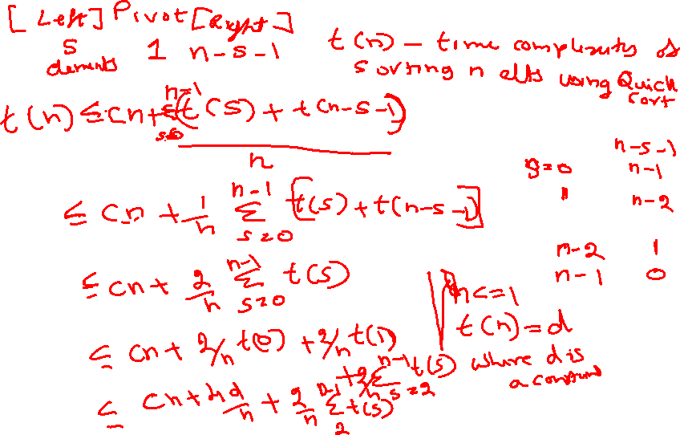

Slide 25
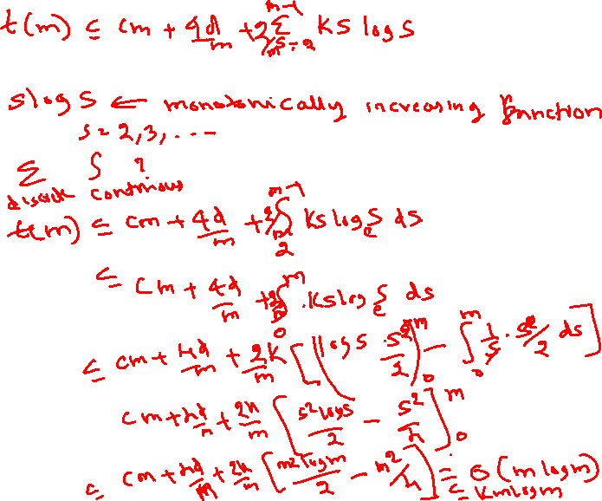

Slide 26
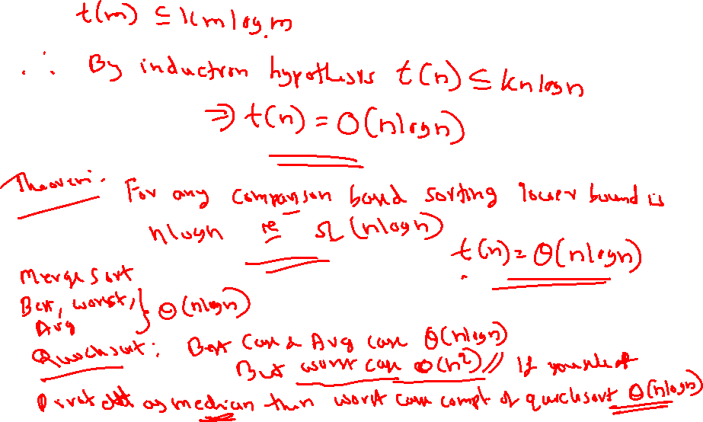

Slide 27
Average Time Complexity of Quick Sort
Let t(n) denote average time complexity of sorting n elements using quick sort
For n <=1, t(n) = d , for some constant d.
t(n) <= cn + 1/n [ ∑₀ ^{n-1} (t(s) + t(n-s-1) ], where s and n-s-1 denote number of elements in the left segment and the right segment respectively.

Slide 28
Average Time Complexity of Quick Sort
Proof by induction: We show that t(n) <= kn logn, where k= 2(c+d)
Base case n=2, t(2) <= 2(c+d)
Assume that theorem is true for n<m , now to prove the theorem for n = m

Slide 29
Average Time Complexity of Quick Sort

Slide 30
Matrix Multiplication

Slide 31
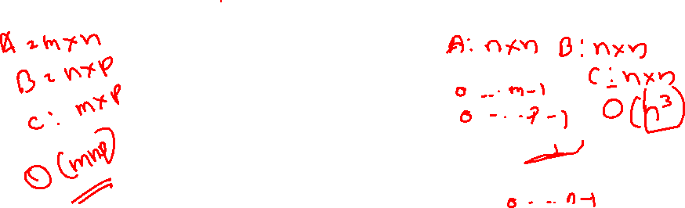
Conventional Matrix Multiplication
for (int i=0; i< n ; i++)
for (int j=0; j<n; j++)
{
c[i][j]=0;
for (int k=0; i<n; k++)
c[i][j]+= A[i][k]*B[k][j];
}
O(n³)

Slide 32
Matrix Multiplication : Divide and Conquer
T(n) = aT(n/b) + f (n) where f(n) ∈ Θ(n^{d}), d ≥ 0
Master’s Theorem:
If a < b^{d}, T(n) ∈ Θ(n^{d})
If a = b^{d}, T(n) ∈ Θ(n^{d} log n)
If a > b^{d}, T(n) ∈ Θ(n^{log b a} )
T(n) = 8 T(n/2) + cn² for n>=2 and T(1)=d
Solve ! ?

Slide 33
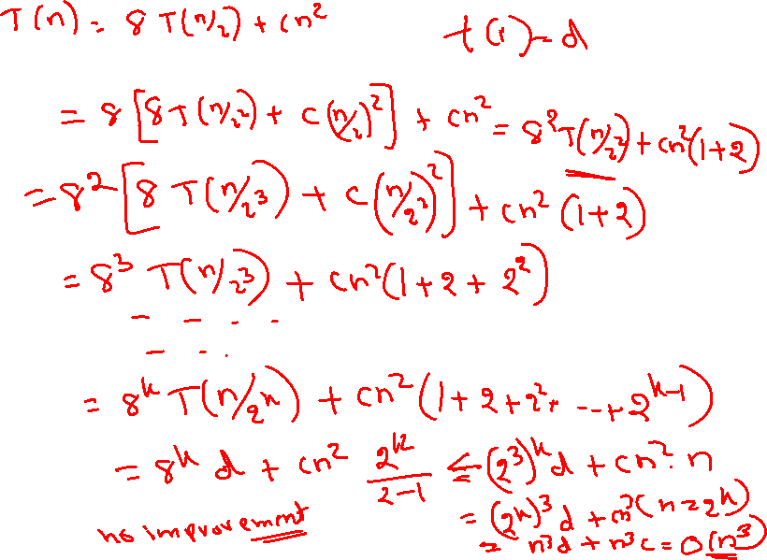

Slide 34
T(n) = 8 T(n/2) + cn² = 8 [8T(n/2²) + cn²/4] + cn²
= 8²T(n/2²) + cn² [1 + 2]
= 8²[8T(n/2³) + cn²/16] + cn² [1 + 2 + 4]
= 8³T(n/2³) + cn² [1 + 2 + 2²]
……
……
= 8^{k}T(n/2^{k}) + cn² [1 + 2+ 2² +… + 2^{k-1}] = O(n³) (Since n= 2^{k})

Slide 35
Analysis of Matrix Multiplication (Using Masters Theorem)
T(n) = aT(n/b) + f (n) where f(n) ∈ Θ(n^{d}), d ≥ 0
Master Theorem: If a < b^{d}, T(n) ∈ Θ(n^{d})
If a = b^{d}, T(n) ∈ Θ(n^{d} log n)
If a > b^{d}, T(n) ∈ Θ(n^{log b a} )
T(n) = 8 T(n/2) + cn²
Comparing the Recurrence Relation with the Masters Theorem we get
a= 8, b=2, d=2
Using Masters Theorem
a > b^{d}
Therefore T(n) ∈ Θ(n^{log b a} )
=> T(n) ∈ Θ(n^{log 28} ) = Θ (n³)

Slide 36
Strassen’s Matrix Multiplication

Slide 37
Formulas for Strassen’s Algorithm
T(n) = 7 T(n/2) + cn² T(2) = d, for some constant d

Slide 38
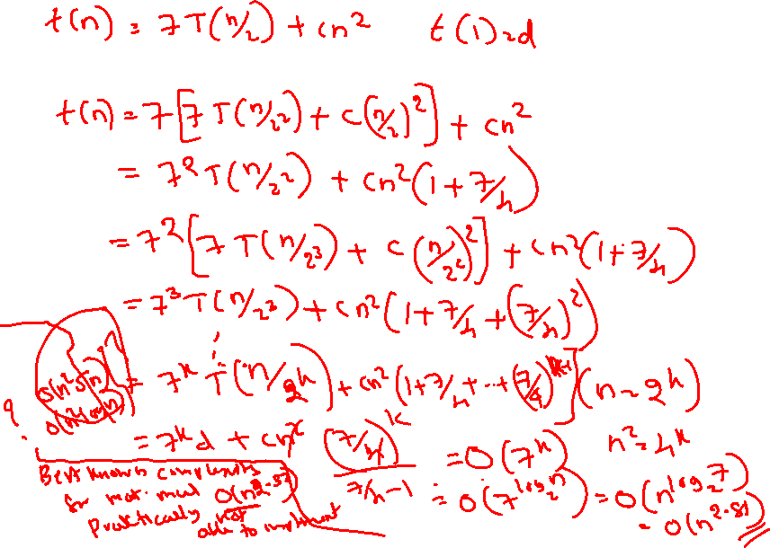

Slide 39
Analysis of Strassen’s Algorithm
T(n) = 7 T(n/2) + cn² T(1) = d, for some constant d
T(n) = 7 T(n/2) + cn² = 7 [7 T(n/2²) + c(n/2)² ] + cn² =
= 7² T(n/2²) + cn² [1 + 7/4]
= 7³ T(n/2³) + cn² [1 + 7/4 + (7/4)²]
…..
…..
= 7^{k} T(n/2^{k}) + cn² [1 + 7/4 + (7/4)² + … (7/4)^{k-1}]
= 7^{k} T(n/2^{k}) + cn² (7/4)^{k} / [7/4 – 1] = O(7^{k} )
= O(7^{logn} ) = O(n^{log 7} ) = O(n^{2.81})

Slide 40
Analysis of Strassen’s Algorithm (Using Masters Theorem)
T(n) = aT(n/b) + f (n) where f(n) ∈ Θ(n^{d}), d ≥ 0
Master Theorem: If a < b^{d}, T(n) ∈ Θ(n^{d})
If a = b^{d}, T(n) ∈ Θ(n^{d} log n)
If a > b^{d}, T(n) ∈ Θ(n^{log b a} )
T(n) = 7 T(n/2) + cn²
Comparing the Recurrence Relation with the Masters Theorem we get
a= 7, b=2, d=2
Using Masters Theorem
a > b^{d}
Therefore T(n) ∈ Θ(n^{log b a} )
=> T(n) ∈ Θ(n^{log 27})

Slide 41
General Divide-and-Conquer Recurrence
T(n) = aT(n/b) + f (n) where f(n) ∈ Θ(n^{d}), d ≥ 0
Master Theorem: If a < b^{d}, T(n) ∈ Θ(n^{d})
If a = b^{d}, T(n) ∈ Θ(n^{d} log n)
If a > b^{d}, T(n) ∈ Θ(n^{log b a} )
Note: The same results hold with O instead of Θ.
Examples: T(n) = 4T(n/2) + n ⇒ T(n) ∈ ?
T(n) = 4T(n/2) + n² ⇒ T(n) ∈ ?
T(n) = 4T(n/2) + n³ ⇒ T(n) ∈ ?

Slide 42
Example: Strassen’s Matrix Multiplication

Slide 43
Exercise
Multiply the following two matrix using Strassen’s Matrix Multiplication Method. Multiply 2 x 2 matrix conventionally.
5 | 10 | 15 | 20
5 | 10 | 15 | 20
1 | 2 | 3 | 4
5 | 6 | 7 | 8
1 | 2 | 3 | 4
5 | 6 | 7 | 8
9 | 10 | 11 | 12
13 | 14 | 15 | 16
450 | 500 | 550 | 600
450 | 500 | 550 | 600
90 | 100 | 110 | 120
202 | 228 | 254 | 280

Slide 44
Exercice
Solve the following recurrence equations using substitution Method and Master’s theorem. In all the examples considered take t(1)=1:

Slide 45
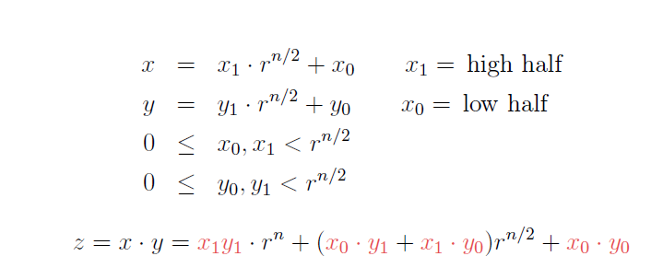
Large Integer Multiplication using Divide and Conquer Approach

Slide 47
Time Complexity

Slide 48
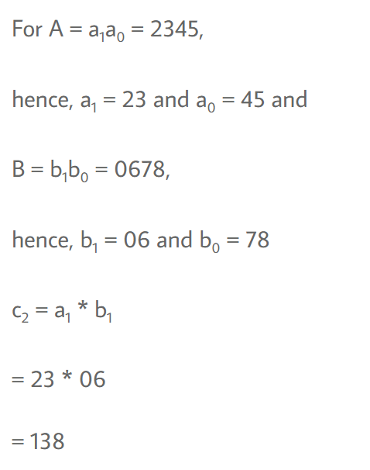
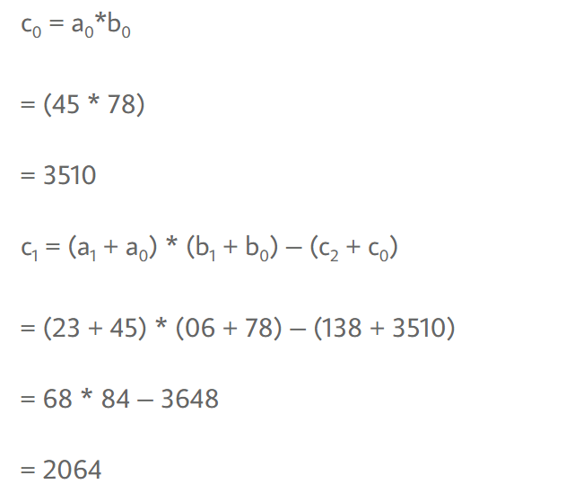

Slide 49
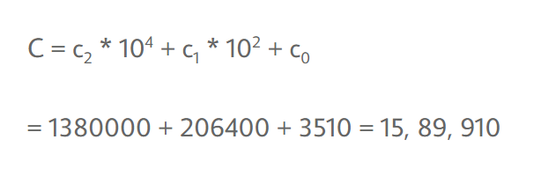

Slide 50
Tutorial
Q1. Multiply the following two matrix using Strassen’s Matrix Multiplication Method. Multiply 2 x 2 matrix conventionally.
5 | 3 | 1 | 2
5 | 1 | 5 | 2
1 | 2 | 3 | 4
1 | 1 | 5 | 5
1 | 1 | 3 | 3
5 | 5 | 2 | 2
2 | 5 | 2 | 5
1 | 1 | 1 | 1
Q2. Solve the following using Master’s theorem

